Slide 1

Strengthening our Global Community
Through Local Action
Douglas C. Comer, Ph.D.
US/ICOMOS President

Slide 2
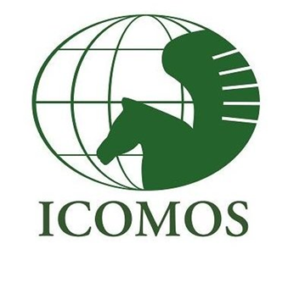



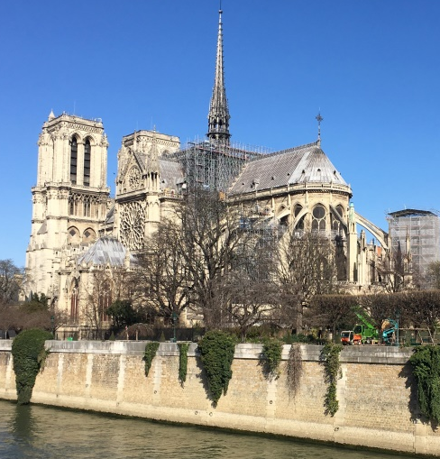

ICOMOS
Founded in 1965, the mission of ICOMOS has been to promote the application of theory, methodology, and scientific techniques to the conservation of architectural and archaeological heritage
ICOMOS France will act as the focal point for ICOMOS on this matter: it will collect the information available and represent ICOMOS at the national level
March 11, 2019, before the fire. Note roof scaffolding.
The façade with bellowers stand even now.
Notre Dame still stands, let us approach the restoration cautiously

Slide 3
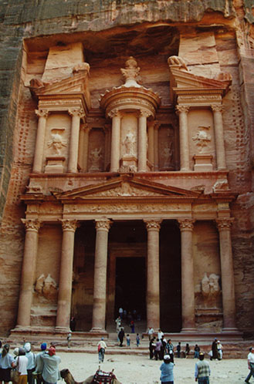
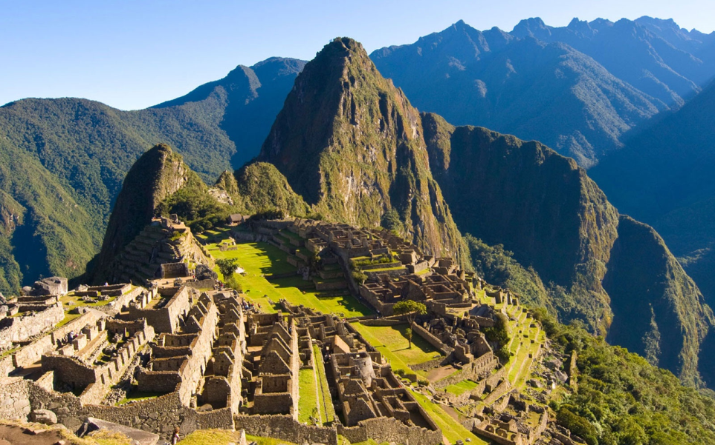
The United States National Committee of ICOMOS
US/ICOMOS is the United States National Committee of the International Council on Monuments and Sites (ICOMOS). It was the first national committee.
ICOMOS might be known best as the body that advises the World Heritage Committee on the inscription of cultural sites nominated to the World Heritage List.
There are 107 national committees and 28 scientific committees
Petra
Machu Picchu

Slide 4
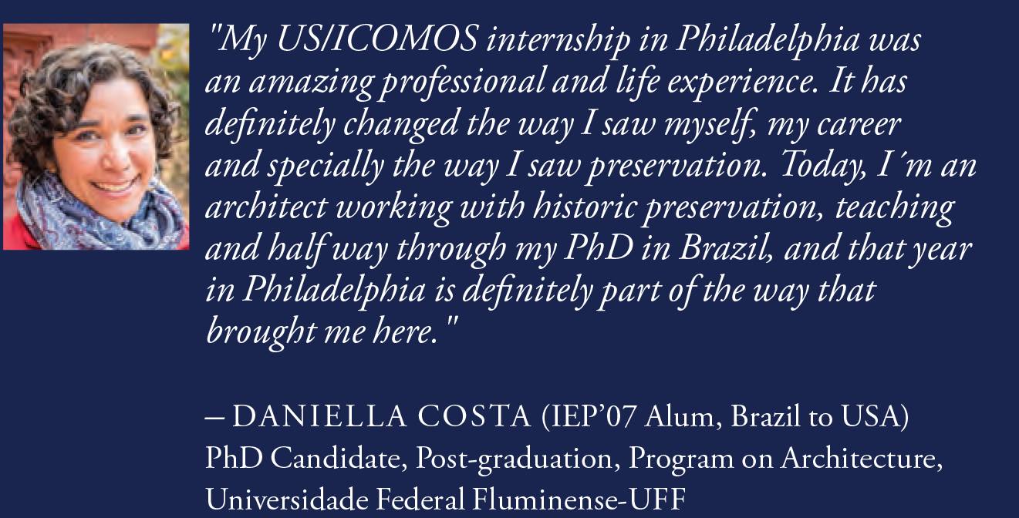
US/ICOMOS Existing
Programs and Activities
International Exchange Program
  Exchange of emerging professional from around the world

Slide 5
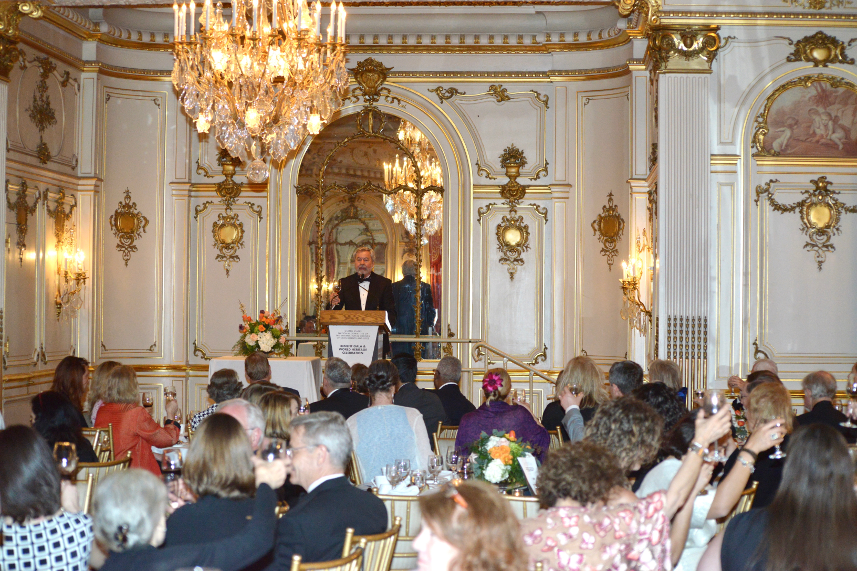
US/ICOMOS Existing
Programs and Activities
Annual Celebration of World Heritage

Slide 6
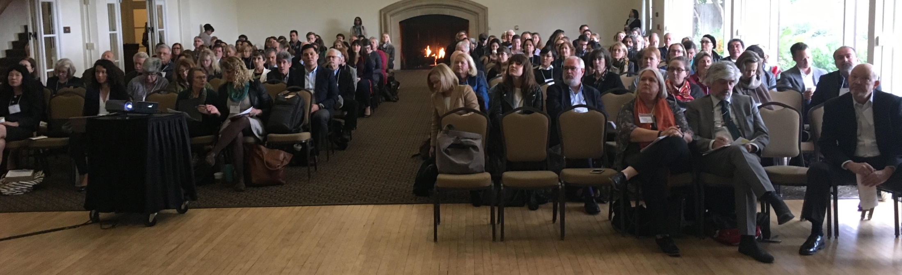
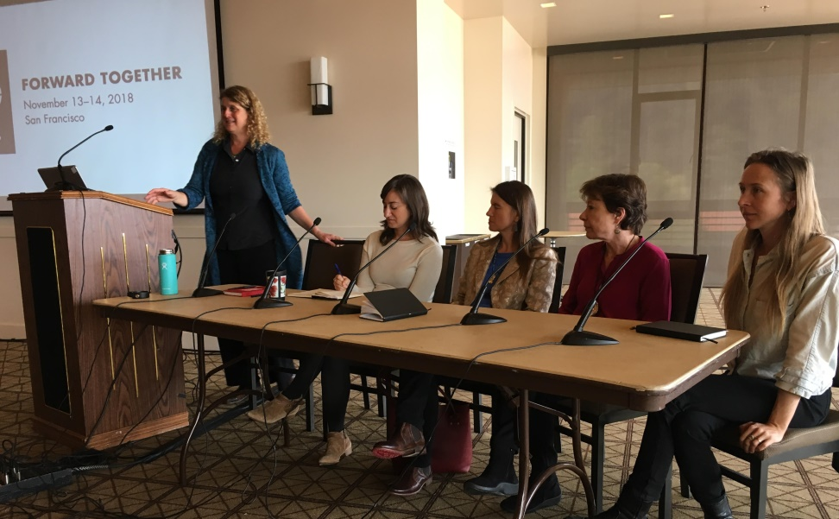
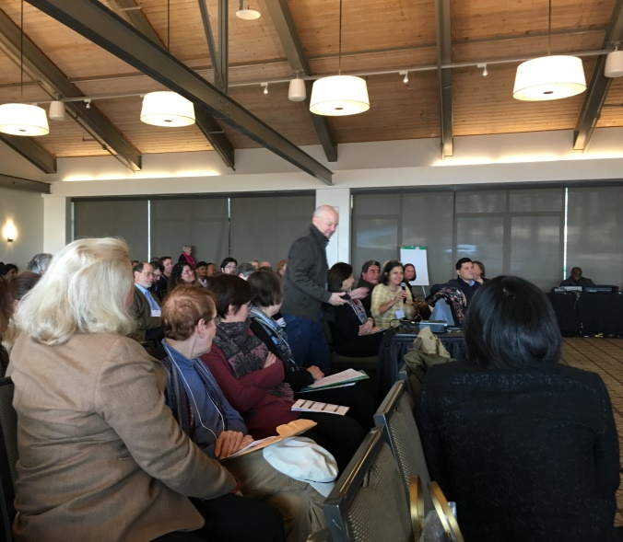
US/ICOMOS Existing
Programs and Activities
Annual Conference and Symposium
An International Symposium on
World Heritage

Slide 7

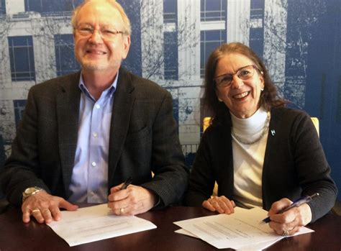
US/ICOMOS Existing
Programs and Activities
US/ICOMOS and U.S. Committee of the Blue Shield
Memorandum of Understanding
Nancy Wilkie, President USCBS and US/ICOMOS, represented by James Reap, US/ICOMOS Executive Committee Member, sign the Memorandum of Understanding

Slide 8
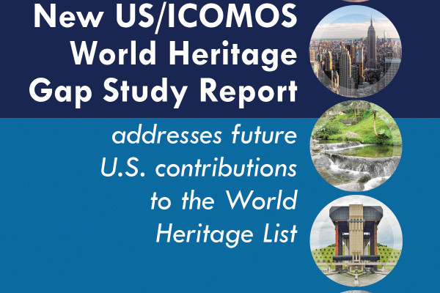
US/ICOMOS Existing
Programs and Activities
Ongoing consultations on the US World Heritage Tentative List
and with sites on the Tentative List

Slide 9
Looking Forward: US/ICOMOS Involvement with ICOMOS Heritage Leadership
Scientific Committees
  Experts who meet to discuss their areas of expertise, resulting in
  doctrine and the evolution and distribution of ideas
US/ICOMOS members are active in ICOMOS Scientific Committees. Many have and are serving as presidents or officers.

Slide 10
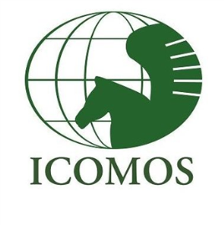
List of ICOMOS International Scientific Committees
ISCARSAH: International committee on Analysis and Restoration of Structures of Architectural Heritage
ICAHM: International committee on Archaeological Heritage Management
ISCCL: International committee on Cultural Landscapes ICOMOS-IFLA
CIIC: International committee on Cultural Routes
ICTC: International committee on Cultural Tourism
ISCEAH: International committee on Earthen Architectural Heritage
ISCEC: International committee on Economics of Conservation
ISCES: International committee on Energy and Sustainability
IcoFort: International committee on Fortifications and Military Heritage
CIPA: International committee on Heritage Documentation
CIVVIH: International committee on Historic Towns and Villages
ICIP: International committee on Interpretation and Presentation of Cultural Heritage Sites ICICH: International committee on Intangible Cultural Heritage
ICLAFI: International committee on Legal, Administrative and Financial Issues
ISCMP: International committee on Mural Painting
PRERICO : International committee on Places of Religion and Ritual
IPHC: International Polar Heritage Committee
ICORP: International committee on Risk Preparedness
CAR: International committee on Rock Art
ISCSBH: International committee on Shared Built Heritage
ISCV: International committee on Stained Glass
ISCS: International committee on Stone
Theophilos: International committee on Theory and Philosophy of Conservation and Restoration CIF: International committee on Training
ICUCH: International committee on Underwater Cultural Heritage
CIAV: International committee on Vernacular Architecture
IWC: International committee on Wood
ISC20C: International committee on 20th Century Heritage

Slide 11
National Committees
How can NCs enhance input at home and internationally into the ICOMOS mission? The role of NCs is to promulgate and implement conservation, protection, use and enhancement of monuments, building complexes and sites; Conveying doctrine and the evolution and distribution of ideas developed by SCs. Conducting advocacy awareness within their countries on many issues including community involvement, engagement of indigenous heritage groups, unregulated tourism, looting, insensitive development, and other destructive activities.
Expressed in National Committee 2018 Annual Reports
What National Committees see as their Role
Promulgate, advocate for and otherwise and implement
  ICOMOS doctrine
  The implementation of the World Heritage Convention

Slide 12
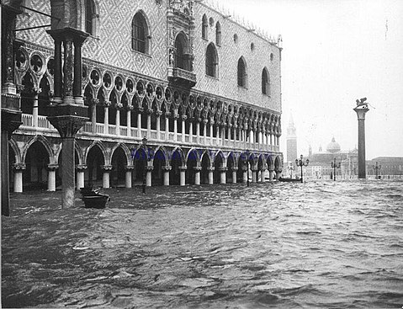
It started with the Venice Charter
Initially, this work was tied closely to the 1964 International Charter on the Conservation and Restoration of Monuments and Sites (better known as the Venice Charter).
Coincidentally, used to guide restoration after the disastrous floods in Venice and Florence in 1966.
Views monuments as historical records as well as works of art
Doge's Palace , Venice, 1966
A cultural benchmark, young people flocked to Venice and Florence to assist, called the “mud angels”

Slide 13
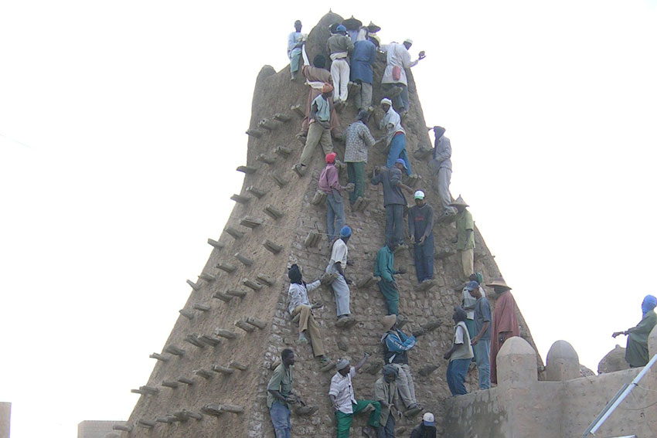
Evolution of Heritage
Over the past half-century heritage theory, method, and scientific techniques have evolved.
A benchmark was the recognition of the interplay of the physical conservation of monuments and sites and the role of intangible heritage in the authenticity of those sites.
the ancient libraries and mausoleums at the World Heritage Sites of Mali (Old City of Djenné, Timbuktu, Bandiagara Cliffs, Tomb of Askia) damaged by ISIS allies were recently repaired by masonry guilds that have done this work for centuries.

Slide 14
New Priorities
Priority: Heritage as a Means of Social and Economic Benefit
The US National Park Service has been assessing economic benefit to local communities for years
Making this replicable for US World Heritage Sites

Slide 15
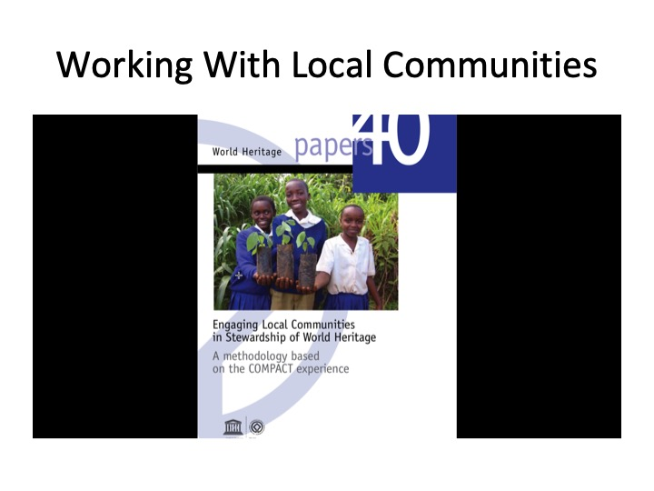
Priority: Social and Economic Benefit
Social and economic benefit generated by World Heritage Sites (our 2019 conference theme)
  Tourism
  Infrastructure development
  Local identities
  Awareness
    Indigenous heritage
    Culture-nature
    2030 SDGs
    Rights-Based Approach

Slide 16
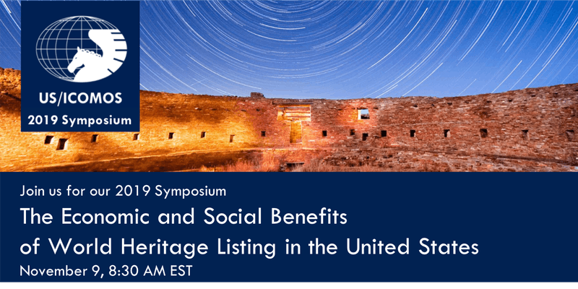
The Economic and Social Benefits of World Heritage Listing in the United States

Slide 17
The Economic and Social Benefits of World Heritage Listing in the United States
The economic and social benefits of World Heritage listing are not well understood in the United States. This conference will provide perspective on the impact of World Heritage designation as well as provide an opportunity to discuss lessons learned by a range U.S. World Heritage sites. Hear from local, national and international heritage experts from World Heritage sites such as the recently inscribed Frank Lloyd Wright sites, and sites that have been listed for many years, such as Chaco Canyon National Historical Park. The symposium will also examine the potential for social and economic benefit to sites on the United States Tentative List, looking at ways to begin planning now for future benefit to local communities.

Slide 18
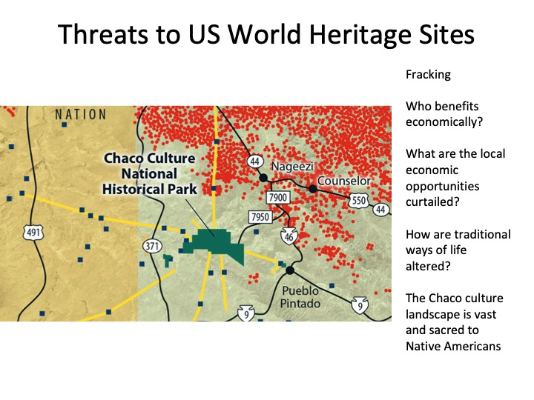
Priority: Indigenous Heritage
Engaging indigenous heritage groups in planning and management at World Heritage Sites
Theme for future conference

Slide 19
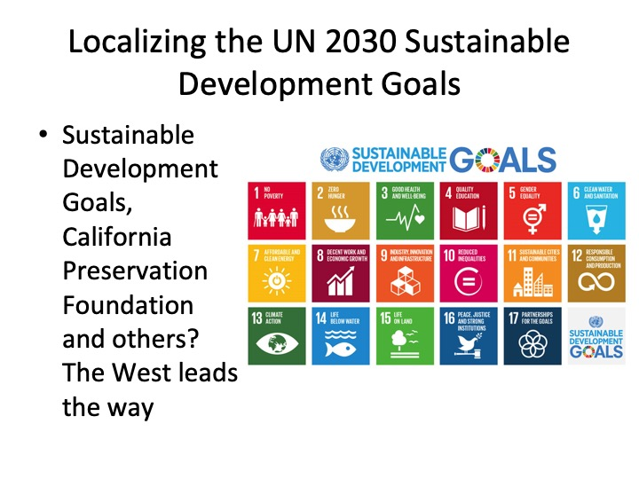
Priority: 2030 Sustainable Development Goals
Encourage all US/ICOMOS members to be active in promoting the UNESCO 2030 Sustainable Development Goals in their communities
How?

Slide 20
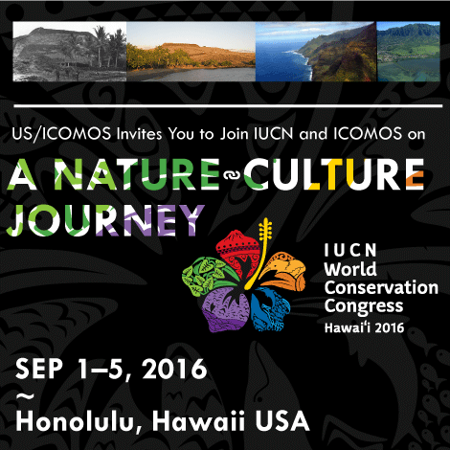
Priority: The Culture-Nature Journey (CNJ)
Informing prospective and current members about our efforts to acknowledge and incorporate the connection between culture and nature in the management of World Heritage Sites and as this applies to their heritage issues
US/ICOMOS led the way in working with IUCN and UCS.
We are closely engaged with ongoing the CNJ, President, US/ICOMOS is the ICOMOS Advisory Committee representative to CNJ

Slide 21
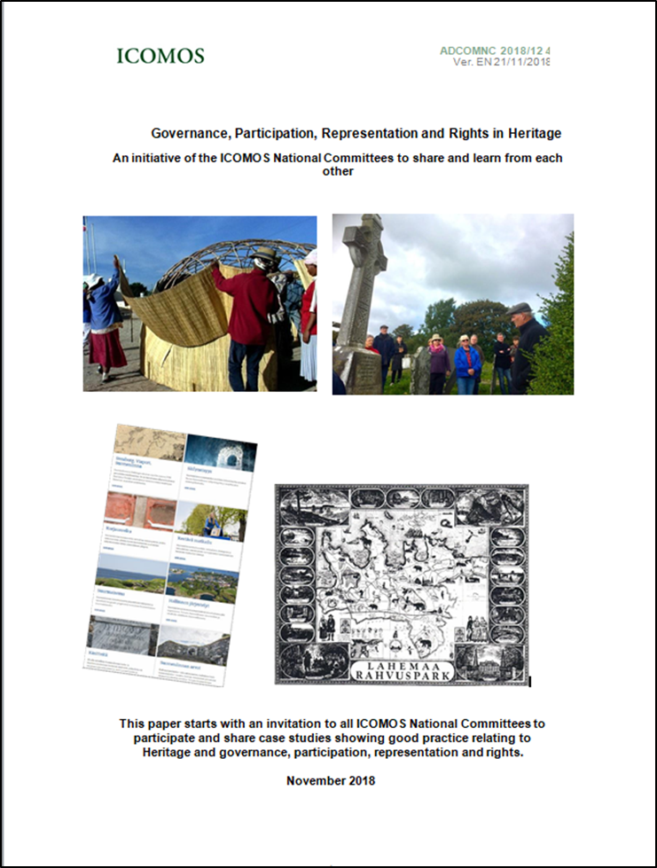
Priority: Rights Based Approaches to Heritage
This initiative aims to gather and share examples of good practice which the ICOMOS community can learn from. It is also a way of showcasing the good work which ICOMOS is involved in and advocates for.
It is not just coincidence that ICOMOS National and other Committees are taking on these issues right now. These themes resonate with the ethical principles of ICOMOS and concern us all:
Good governance procedures and practice
Open, easy and inclusive access to participate
Fair, full and diverse representation
Understanding and practice of rights within the realm of cultural heritage – implicating duty bearers and rights holders

Slide 22
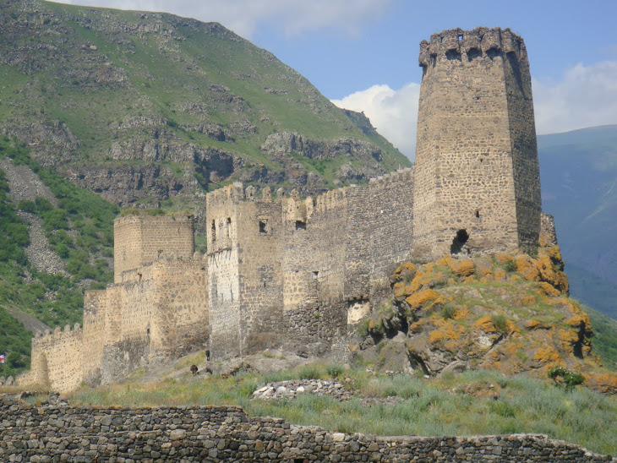
Priority: Case Studies
ICOMOS Estonia
  RBA principles in protecting Lameman National Park cultural heritage: rightholders take part in government and legislation change
    (1) local community defines and is active participant in defining cultural heritage;
    (2) local community preserves and is the main partner in preserving and introducing cultural heritage,
    (3) local community should have historical rights of using nature and heritage as resource;
    (4) local community must give informed consent to the inventories and separate plans (including building plans) on their territory before it is put to action. Main mechanisms to do that are written there a well.
An outcome of the 2020 US/ICOMOS Conference could be a case study on Grand Canyon, Chaco, etc, co-authored by a Native American group

Slide 23
Priority: Emerging Professionals
Journey to Authenticity
Toshi Kono, ICOMOS President, has suggested a Journey to Authenticity. ADCOM is organizing an effort by the Emerging Professionals Working Group (EPWG) to offer new perspective on authenticity. The perspectives would be from each individual scientific and national committee.
In the US, Native American cultures hold the Grand Canyon and all forms of life in ot as sacred. To remove or add species would lessen authenticity in a sense.
Zoe Lueng will represent US/ICOMOS. Lead EPWG members is Stacy Vallis, ICOMOS New Zealand. Lead ACO member is Sheridan Burke. Australia.

Slide 24
US/ICOMOS Representatives to
ICOMOS Working Groups
Emerging Professionals: Zoe Lueng
Climate Change: Adam Markham
Culture-Nature: Douglas Comer (at present)
Membership: Vacant
Sustainable Development Goals: Wayne Donaldson
Rights-Based Approach: Vacant
Indigenous Heritage: Douglas Comer (at present)

Slide 25
US/ICOMOS Committees
Activated
  Executive Committee
  IEP Committee
  Advocacy
  Conference Program Committee
  Celebration of World Heritage
Sequence of Activation:
  Communication
  Membership
  Development
  Personnel
  Finance Committee

Slide 26
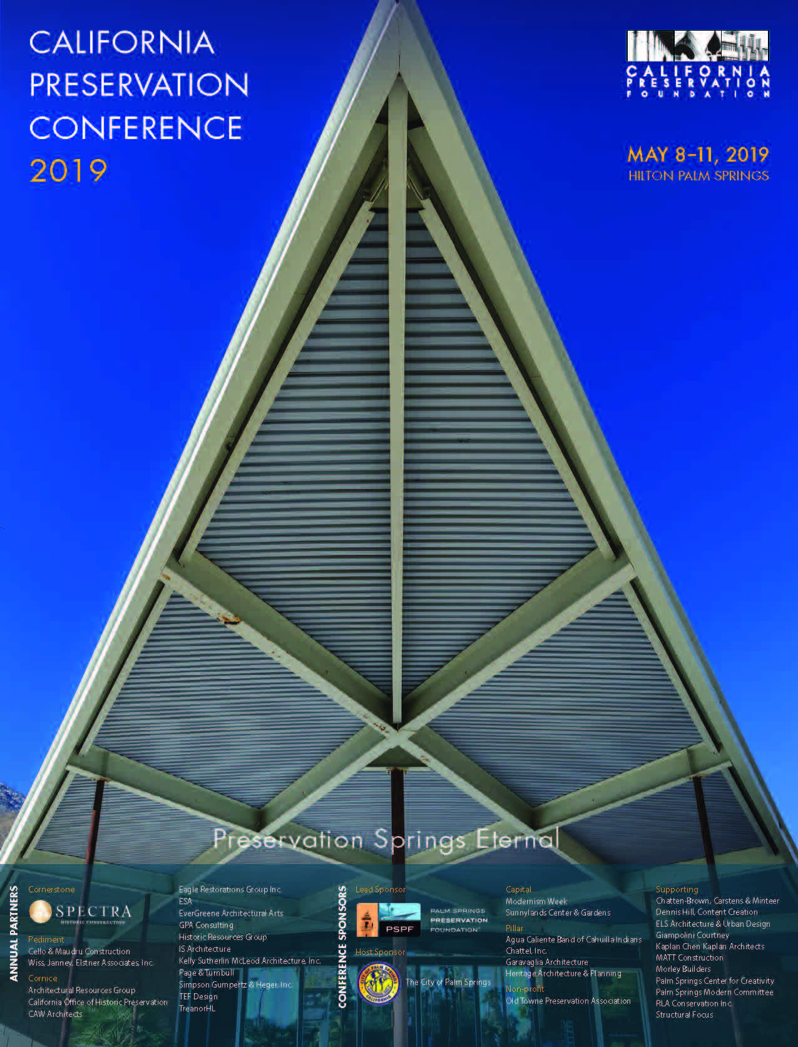
Regional National Chapters
Much interest in this at ICOMOS International, Russia has just begun this and membership in ICOMOS Russia has increased dramatically
Representation by regions that are concerned with under-representation (e.g., Puerto Rico in the US, other regions in other countries)
Feasibility assessment of a US/ICOMOS West Coast Chapter (benefits to US/ICOMOS include more effective advocacy, localization of SDG 2030 goals, increasing membership)
  CPF Meeting, 6-8 May 2019

Slide 27
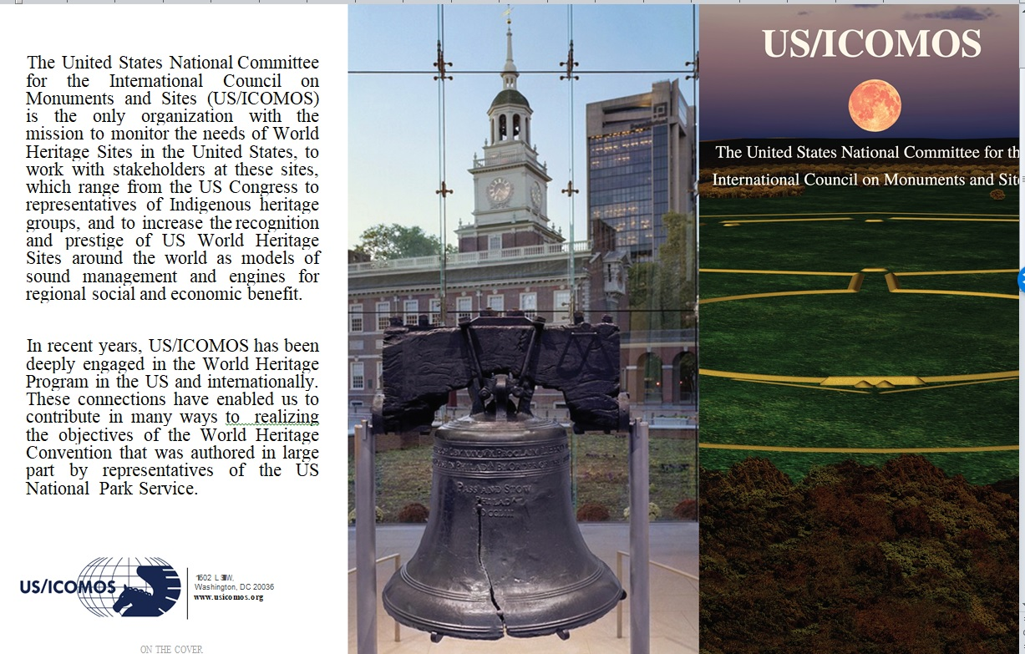
Fundraising/Donations/Sustaining Sponsors

